Slide 1

LESSON 7 TOEIC WRITING Questions 6-7

Slide 2
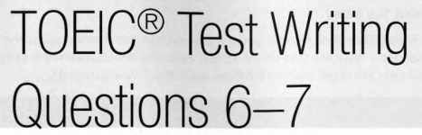
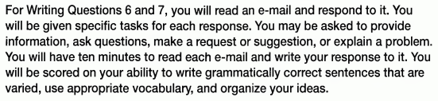
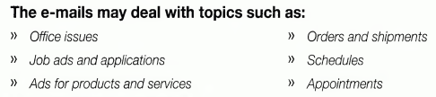
Page 111

Slide 3
01
QUICK GUIDE

Slide 4
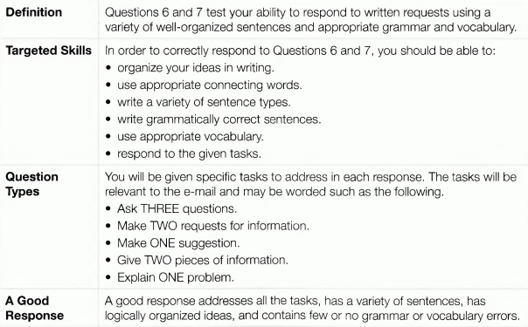
Page 111

Slide 5
Things to remember
1- Begin your e-mail with an appropriate introduction.
2- Keep your audience in mind.
You may be responding to an e-mail from a boss, a job hunter, a
repairperson, or someone else.
Use language appropriate for the audience.
3- Be sure to address all the tasks in your response.

Slide 6
02 Walk through
Page 112

Slide 7
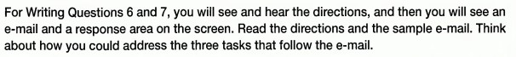
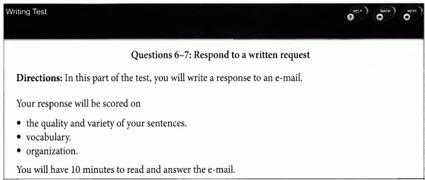
A. What you’ll see
Page 112

Slide 8
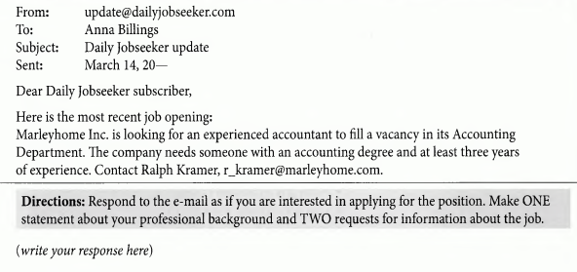
Read the e-mail
Page 112

Slide 9
B. What you’ll do
Page 112
In groups, write a response to this e-mail
(10 minutes)
Compare your answer to the sample

Slide 10
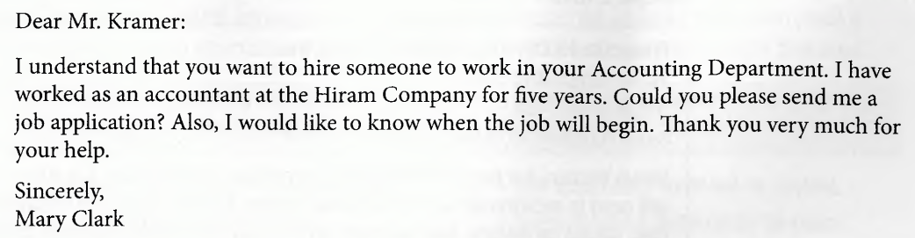
Sample response
Page 112

Slide 11
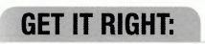
03
Tips and tasks for answering correctly
Page 113

Slide 12
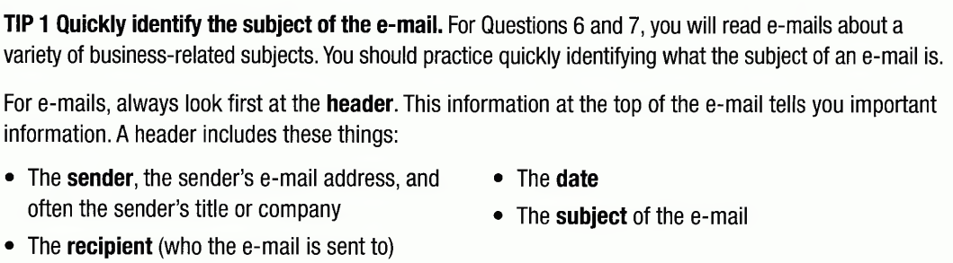
Understand the e-mails and the questions
Page 113
Tip 1

Slide 13
Read the e-mail
Page 112
the sender
the recipient
the subject
HEADER
the date

Slide 14
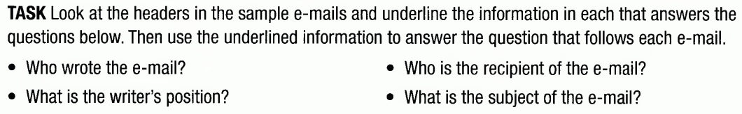
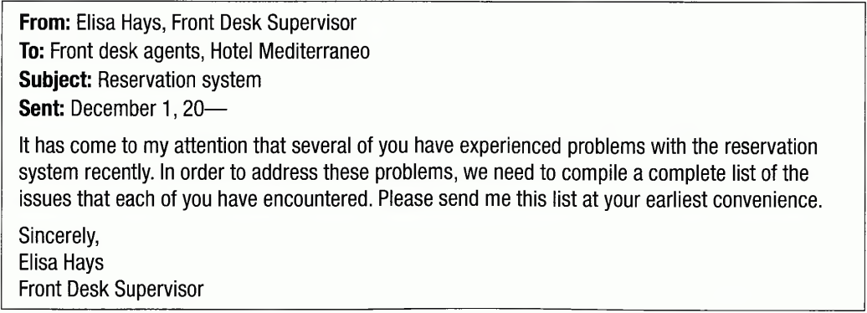
Understand the e-mails and the questions
Tip 1
Page 113

Slide 15
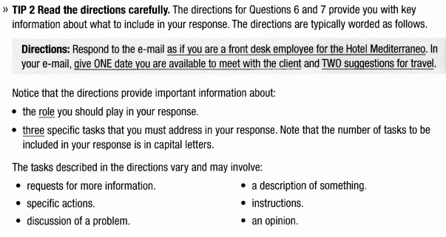
Page 114
Tip 2

Slide 16
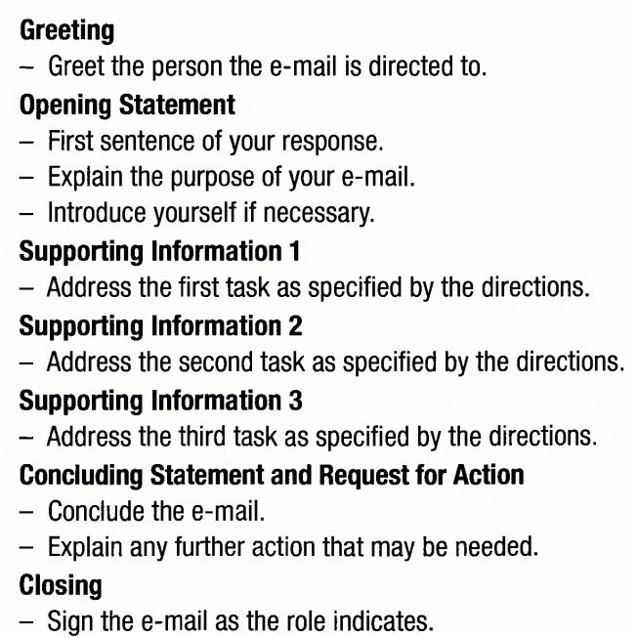
Structuring your response
Tip 1: Learn the basic template for a successful response.
A good response usually include these parts

Slide 17
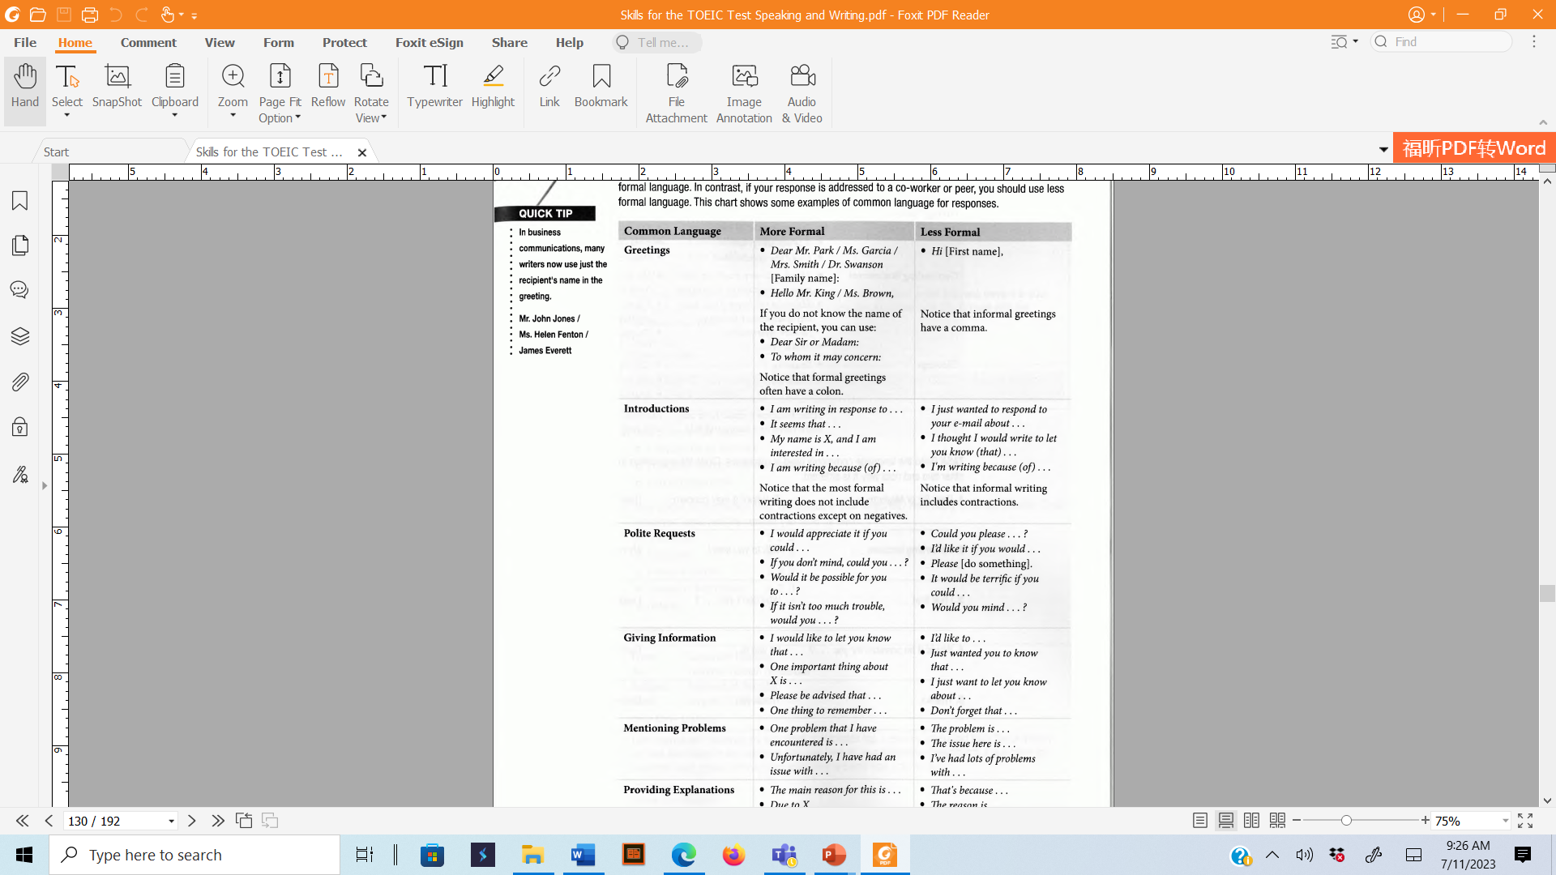
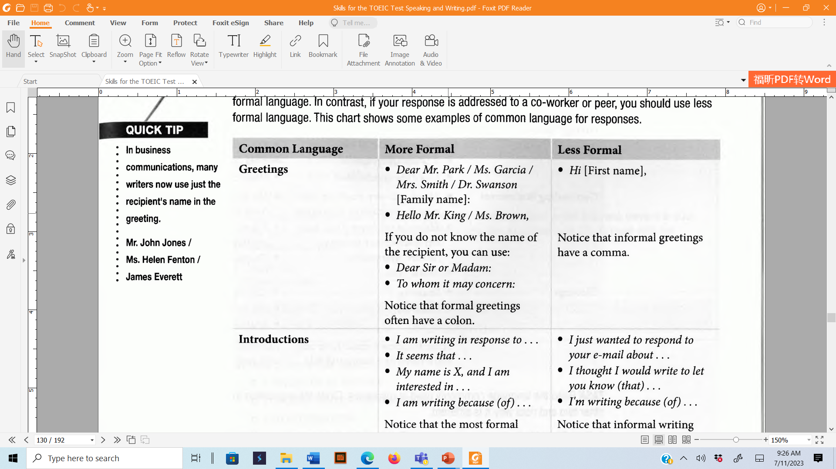
Structuring your response
Tip 2: Learn common languages used to respond
Quick tip

Slide 18
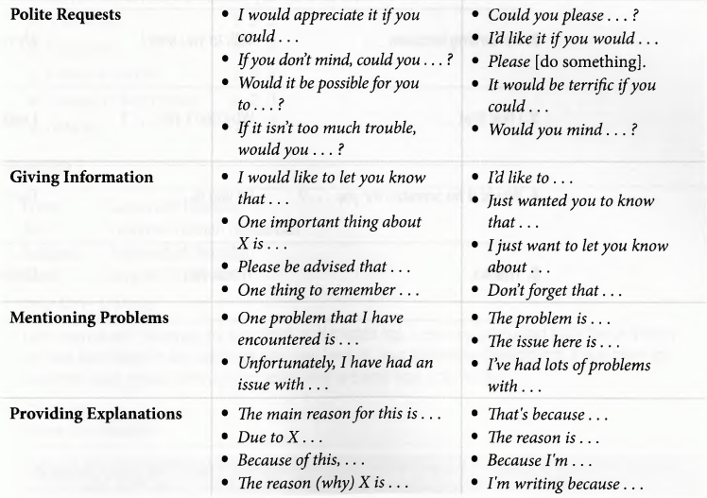

Slide 19
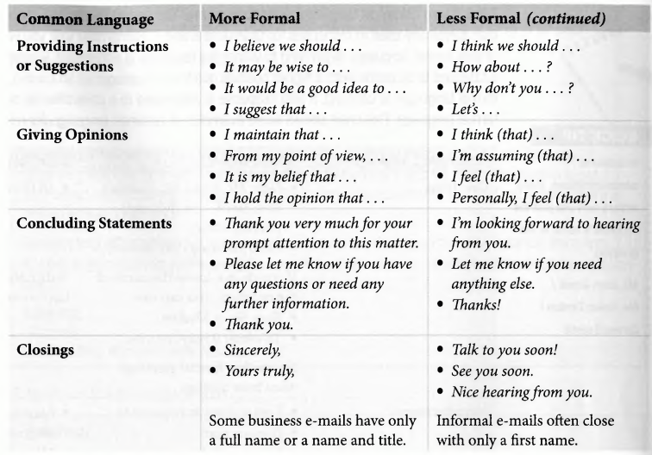

Slide 20
HOMEWORK

Slide 21
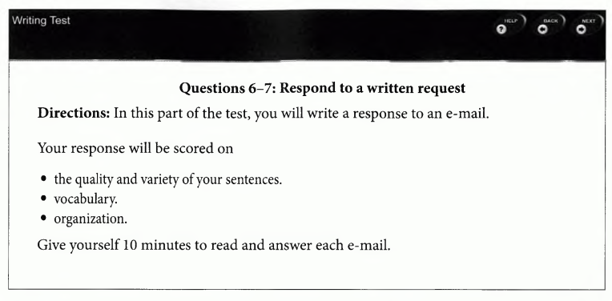
GO FOR THE TOEIC TEST

Slide 22
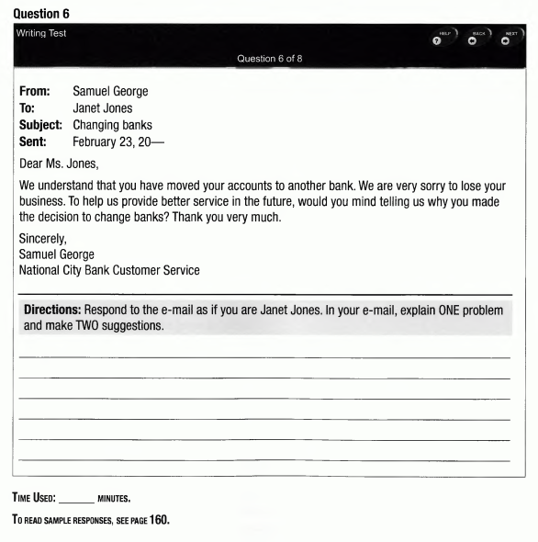

Slide 23
